Slide 1
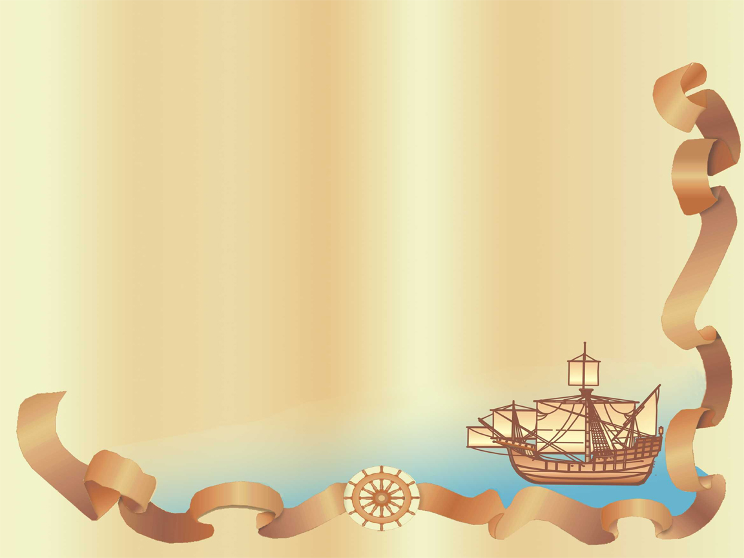
CHAPTER 1 – COLLIDING WORLDS (1450-1600)
Exploration & Conquest

Slide 2
Portuguese Expansion
-1394-1460 CE – Henry the Navigator (prince of Portugal) establishes navigation school, innovation of caravel sailing ship, and sponsors voyages that lead to colonization of Madeira & Azore Islands and trade expeditions to West African coast
-By 1500 CE, Europeans establish plantations in Canary & Cape Verde Islands, Sao Tome off African Coast (wine, dyes, sugar)
-Europeans maintain fortified coastal trading posts, as interior remained hostile due to native resistance & prevalence of disease
-1488 CE – Explorer Bartolomeu Dias rounds Cape of Good Hope at southern tip of Africa
-1498 CE – Vasco da Gama reaches India & returns with spices; establishes Portuguese military/trading presence in Indian Ocean
-Portuguese, then Dutch, would replace Arabs as leaders of Asian commerce (advantage: gunpowder)

Slide 3
African Slave Trade
-African slavery a norm before European contact; bondage tied to debt, as exchange for food, war captives, concubines
-700-1900 CE – Estimated 9 million sold in Tran-Saharan slave trade
-Europeans transition from prioritizing gold/commodities to slaves, who could populate their sugar plantations as forced laborers

Slide 4
16th Century Excursions
-1474 CE – Spanish monarchs Ferdinand of Aragon & Isabella of Castile marry and unite Spain
-1492 CE – Spanish crown concludes Reconquista – expulsion of Muslims from Spain. Also agrees to sponsor Christopher Columbus
-Spanish Inquisition – Program initiated by Catholic Church & Spanish crown to hunt/torture/expel/convert suspected heretics

Slide 5
16th Century Excursions
1. Columbus and the Caribbean
-Genoese mariner Christopher Columbus lobbies for 6 years to gain sponsorship of a voyage west across Atlantic Ocean to reach Asia
-Aug 1492 CE – Columbus leaves with 3 Spanish ships on 6 week journey; lands in Bahamas but mistakes it for West Indies (‘Indians’)
-Columbus makes 3 additional voyages through 1504 CE, settling 1,000+ men & cattle/horses in West Indies, gaining tribute from local Taino/Arawak tribes, converting natives to Christianity, yet never finding any evidence of vast quantities of gold of Asia
-1500 CE – Amerigo Vespucci’s exploration of South America’s coast offers proof that new continents are a “new world”, not Asia

Slide 6
16th Century Excursions
2. The Spanish Invasion
-1513 CE – Juan Ponce de Leon discovers Florida; Vasco Nunez de Balboa crosses Panama to see Pacific Ocean
-Hundreds of conquistadores poised to travel to New World for chances at riches, titles, and in the name of faith (“Gold/Glory/God”)
-1519 CE – Hernan Cortes leads 600 men across Yucatan Peninsula into Mexico; gains Aztecs’ tribal enemies as allies, and marches on capital Tenochtitlan. Emperor Montezuma welcomes them (believing them gods), only to be captured/killed in Aztec rebellion.

Slide 7
16th Century Excursions
-1521 CE – Aztec Empire crumbles, disoriented without leader and amidst widespread disease (smallpox) natives had no immunity to
-1524-1535 CE – Francisco Pizarro kidnaps/ransoms/kills Incan Emperor Atahualpa; 168 conquistadores/horses defeat Inca warriors
-1500-1800 CE – Demographic disaster in Americas, as native populations suffer near 90% loss due to conquest and disease

Slide 8
16th Century Excursions
3. Cabral and Brazil
-1500 CE – Pedro Alvares Cabral drifts off African coast to Brazil; King Dom Joao III sends settlers in 1530’s to stake Portugal’s claims
-Sugar plantations established, first utilizing Native Americans, then imported Africans as laborers; conditions brutal

